Slide 1
Air France Internet Marketing Optimization
Team 9
Bruno Medeiros
Di Guo
Elizaveta Chaplygina
Guilherme Reple
Lohith Chittamuru
2/04/2019
02/06/2019

Slide 2



Context
Global Airline revenue growth slowing down
Number of households using Internet is increasing
Search Engines drive bookings

Slide 3
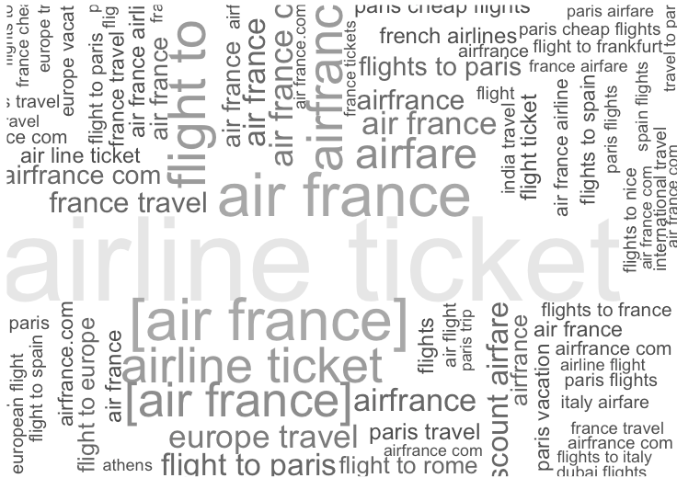

Slide 4
Executive Summary
Identified KPIs to select best performing campaigns:
Volume of Bookings
Return On Advertising
Total Costs
Optimize the budget allocations:
Drop expensive words that generate 0 bookings (”flights”, “french”)
Remove key words that intersect with Kayak business model (discount airfare)
Kayak outperforms search engines in bookings and ROA

Slide 5
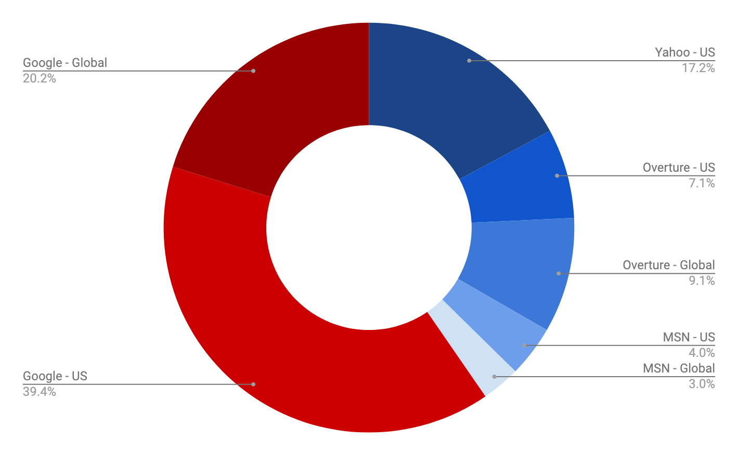
Volume of bookings
Google (US, Global)
and Yahoo
account for 76.8%
of all bookings
Source Air France data

Slide 6
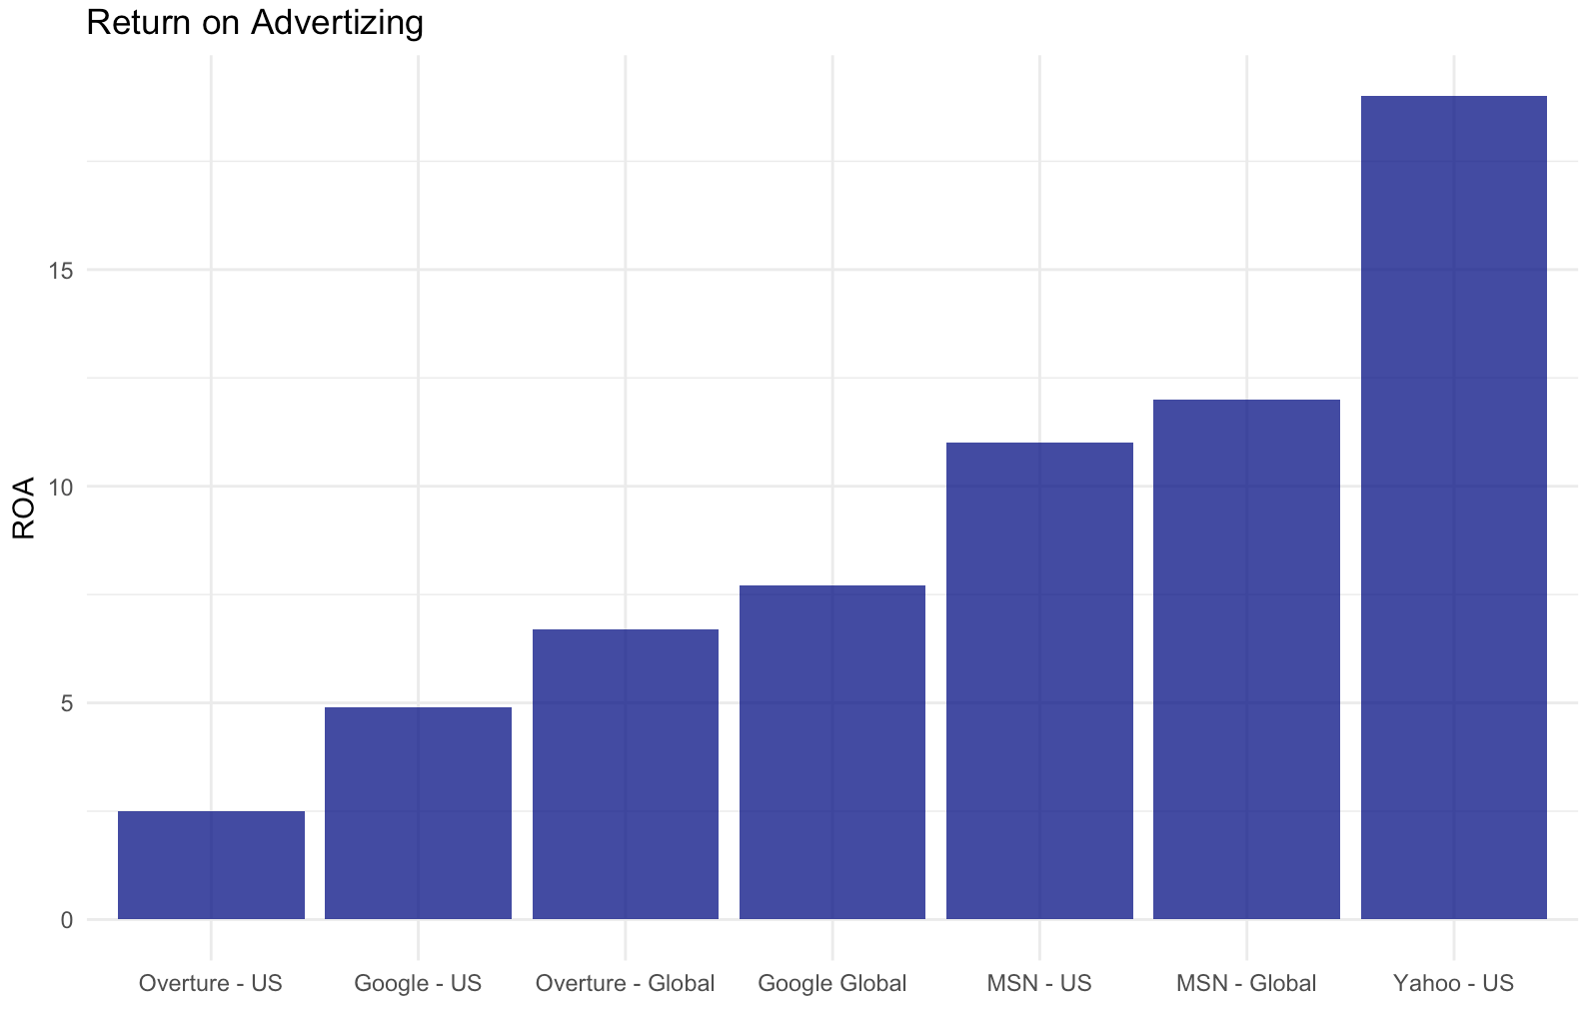
Current Publisher ROA
19.01
Yahoo less bookings, bigger ROA
11.97
11.28
7.69
6.69
Google more bookings, smaller ROA
4.94
2.45
Source Air France data

Slide 7
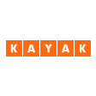
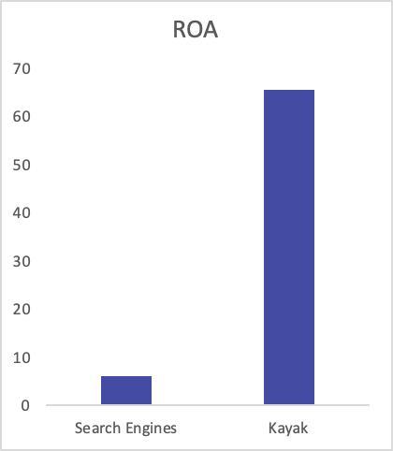
Kayak is the Future
Business Model - Cheap, Deal, Discount – Price Sensitive
Kayak ROA $65.51
Search Engine ROA $6.17
Kayak’s ROA is three times as big as top Publisher (Yahoo).
65.51
6.17
Source Air France data
Notes:
There are some signs of economic slowdown so we expected customers to be more price sensitive, looking for the cheapest flights, Kayak offers exactly that match!
And

Slide 8
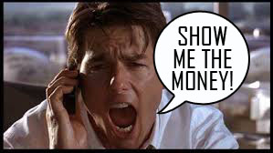
Show me the Money - Cut Expenses
90 % of key-words are bringing 0 revenue
Keep those which give impressions and clicks
Key-words with Cheap, discount and deals.
Cannibalize our market-share.
Cost - $17,331
Bookings - 31
ROA - $2.40
Notes:
We decided to desinvest in the keywords that bring 0 revenue and have low impressions and clicks while keeping those that give a lot of impressions and clicks, because brand awareness is still importante.
Leave the bid war for the cheap, discount and deals keywords – they have a low performance on our KPI’s and that’s Kayak biggest competitive advantage.

Slide 9
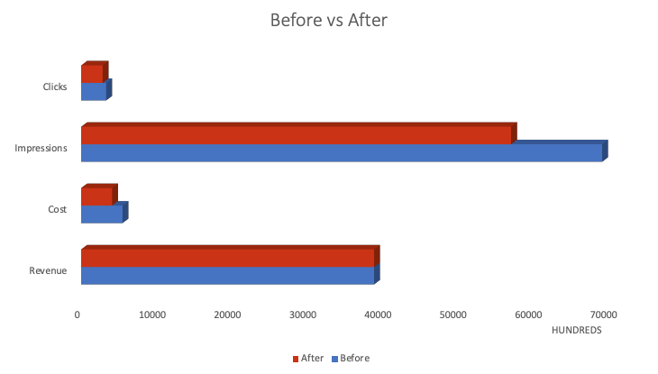
v
Cost Optimization
-17%
25.1% decrease in cost while maintaining the revenue
$137k
Source Air France data

Slide 10
Allocation Strategy
$137,872.30
$55,148.92
Air France Branded
Air France Branded & French Destinations
$82,723.38
Kayak
Air France Global Campaign
Google - US
Yahoo - US
Google - Global
MSN - Global
MSN - US
Google Global
33%
40%
40% of savings to top 3 campaigns
33%
Savings
33%
60% of savings to Kayak
60%
Notes:
2006 – a year expected by many to be Yahoo's best – turned out dismally. Brand-advertising growth fell by half, while Yahoo's share of search-related advertising dropped from 32 to 24 percent, according to Piper Jaffray. (During the same period, Google's edged up from 64 to 68 percent.)

Slide 11

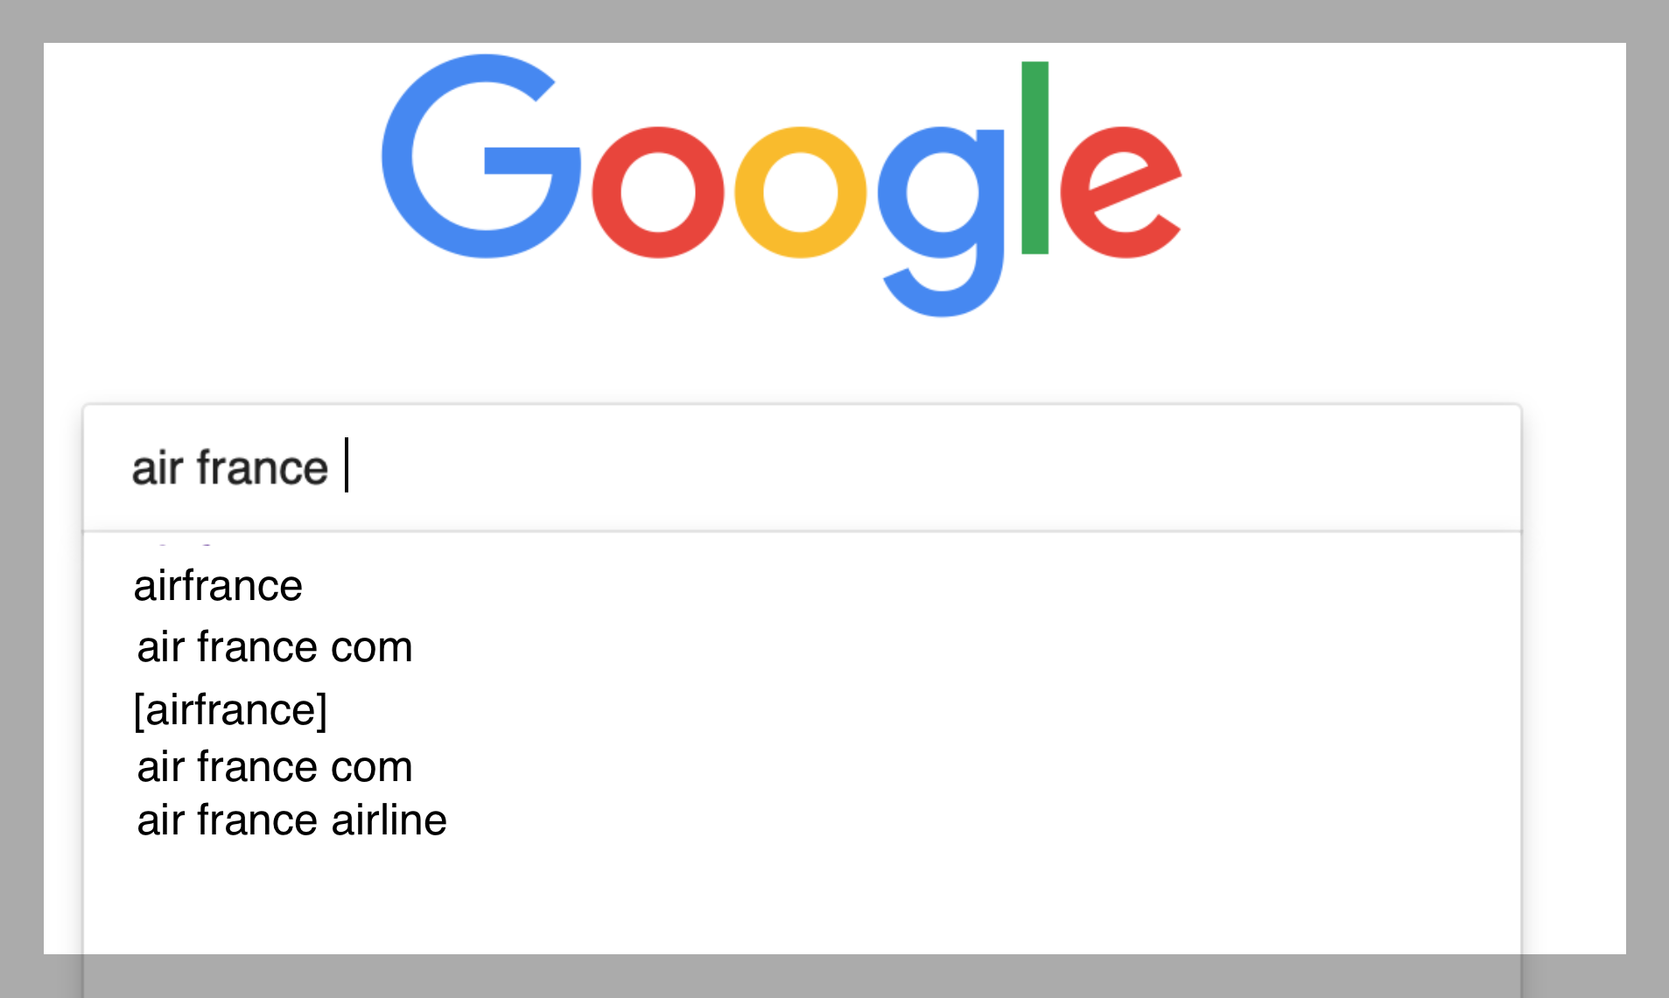
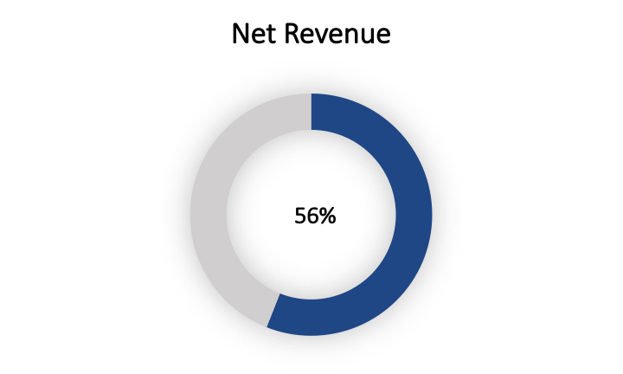
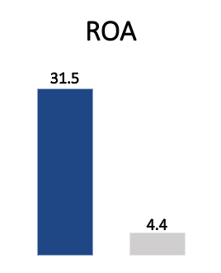
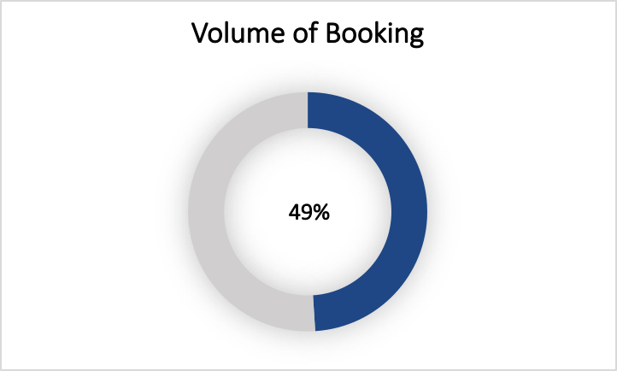
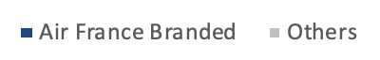
Air France Branded
+
Notes:
2006 – a year expected by many to be Yahoo's best – turned out dismally. Brand-advertising growth fell by half, while Yahoo's share of search-related advertising dropped from 32 to 24 percent, according to Piper Jaffray. (During the same period, Google's edged up from 64 to 68 percent.)

Slide 12
Executive Summary
Future Campaign Optimization:
Air France Branded
Air France Branded & French Destination
Air France Global Campaign
Future Budget Allocation:
Invest 40% on top 3 campaigns
Invest 60% on Kayak

Slide 13
Further Research
?
Search Engine Bid Strategy has no historical data to assess competition.
?
Time frame is confusing and would be helpful to make comparisons with Aggregator.
?
Interesting to see Kayak performance over time. Get Seasonal input.

Slide 14

Time for some questions?!?

